Slide 1
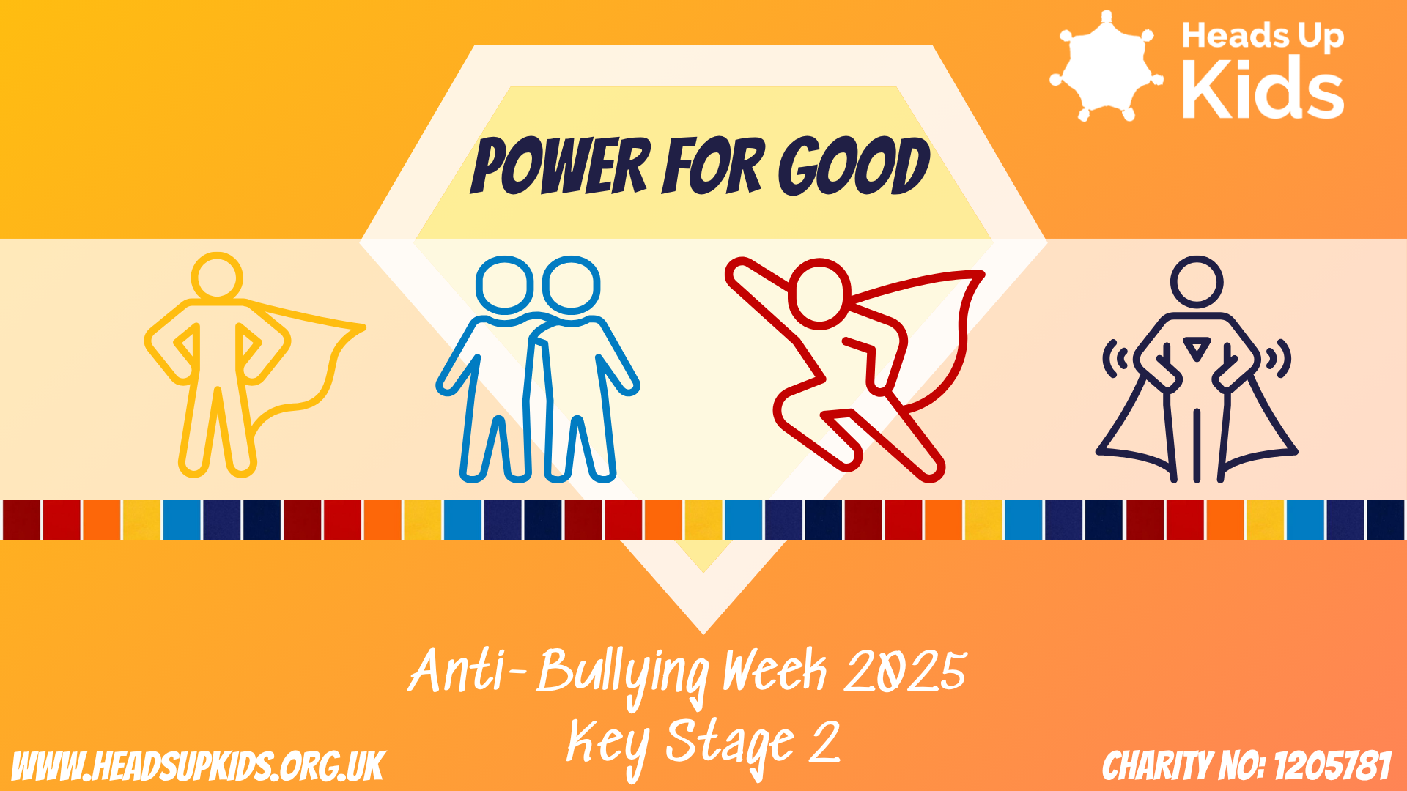

Slide 2


This week is anti-bullying week and the theme is ‘Power for Good’ We are going to think about…
What is bullying?
What are our powers for good when we see bullying?
How do we use our power for good with classmates who are not our friends?
How do we use our power for good even when we don’t like someone?

Slide 3

What is bullying?
That means it happens again and again and isn’t a one-off
Bullying is repetitive

Slide 4
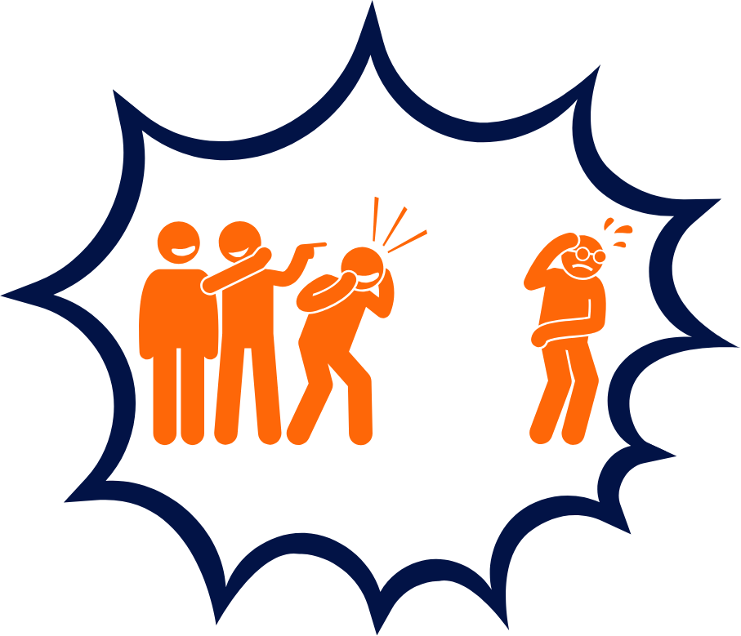

What is bullying?
Bullying is intentional
That means that the person or group doing it means to upset or hurt the person they are bullying

Slide 5
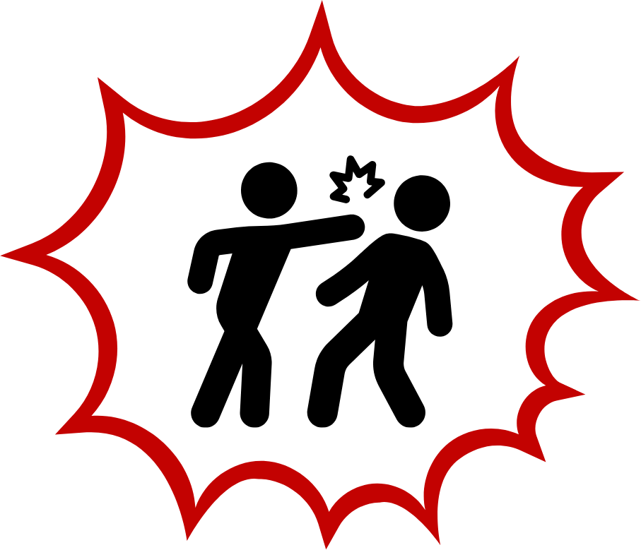
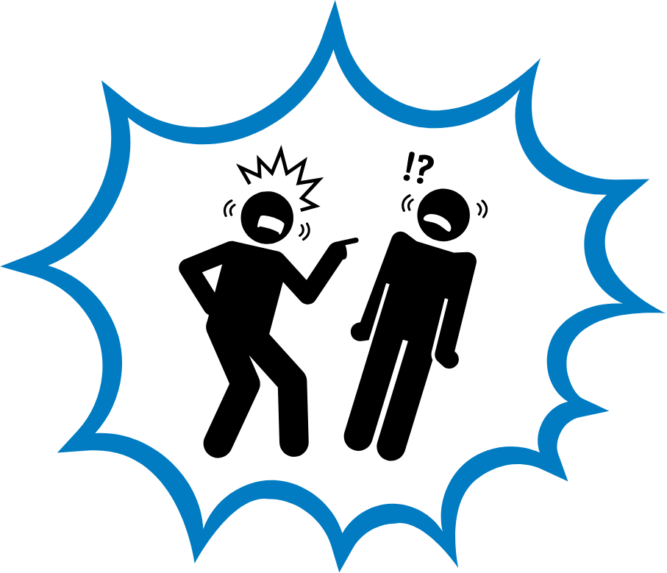
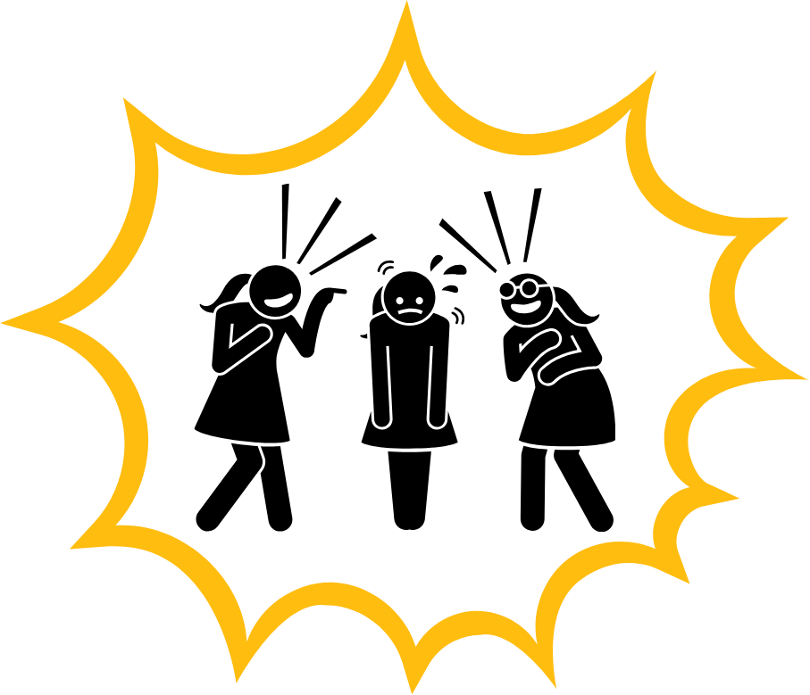

Types of Bullying
Physical
hitting, kicking, pushing or damaging someone else's things on purpose
Verbal
name calling, teasing, saying nasty or unkind things to someone
Emotional
Saying things that aren’t true, playing unkind jokes or leaving people out.
Online
writing hurtful messages, posts or comments on social media or messages

Slide 6


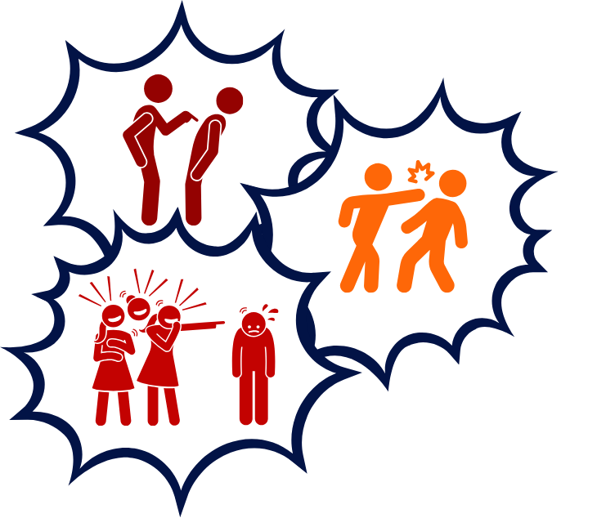
Who is involved in bullying?
‘Bystander’
Someone who sees bullying happen
‘Target’
Someone who experiences bullying
‘Bullies’
A person or group that use bullying behaviour

Slide 7

What are our powers for good if we see bullying?
Ask someone if they need help
Ask someone if they want to join in
Stand up for the person being bullied, say ‘no, that's not ok’.
Or say ‘Stop!’
Tell a teacher or ask someone to come help
Give someone a hug or hold their hand
Take someone away from the situation and go somewhere else

Slide 8

How do we use our powers for good with classmates who are not our friends?

Slide 9
We can…
still be friendly even with people who we wouldn’t call our friends
talk to someone if they are on their own
help someone if they are struggling
include someone in a game
not make a fuss if we have to work together in class
show interest in them and make conversation

Slide 10
How do we use our power for good even when we don’t like someone?
We all have times when we don’t like someone (grown ups included!) but we still have to behave nicely to them.
What are your ideas about how we can do this?

Slide 11
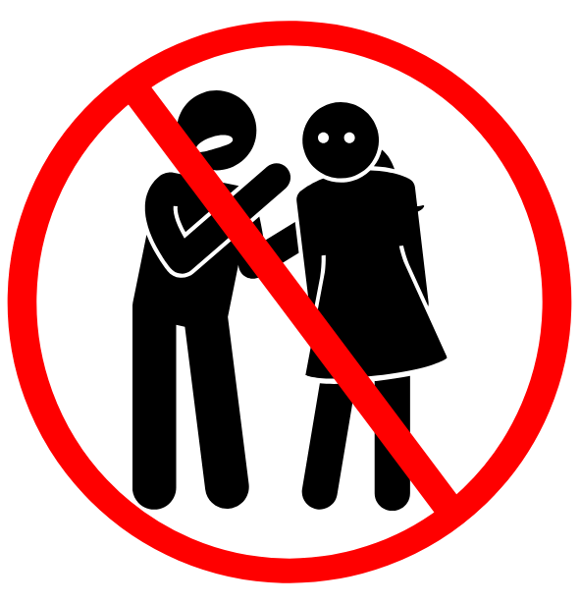
Powers for Good - when you don’t like someone
1. You don’t have to tell everyone: You don’t have to like someone, but you don’t have to tell everyone else or talk about them to others.

Slide 12


Powers for Good - when you don’t like someone
2. Don’t put them down: If you don’t like something about someone you don’t need to make them feel bad about themselves
That means we don’t…
call people names
make comments about their looks or abilities
tell them they aren’t good enough
laugh at them

Slide 13

Powers for Good - when you don’t like someone
3. Don’t exclude: Just because you don’t like someone doesn’t mean they shouldn’t be part of group activities or that they should be isolated or alone.

Slide 14
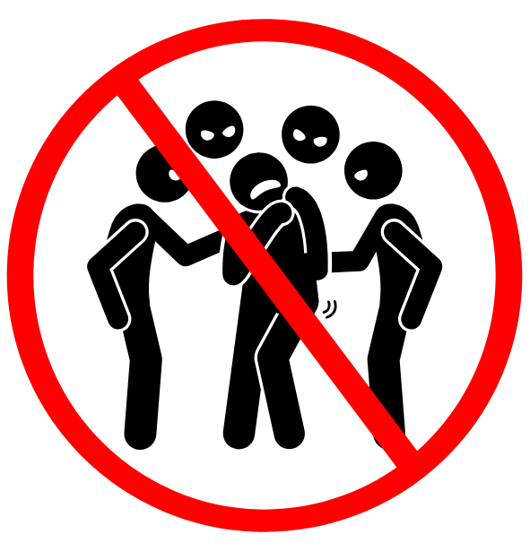
Powers for Good - when you don’t like someone
4. Don’t gang up or try to involve other people: You might not like someone, but it doesn’t mean you involve your friends.

Slide 15
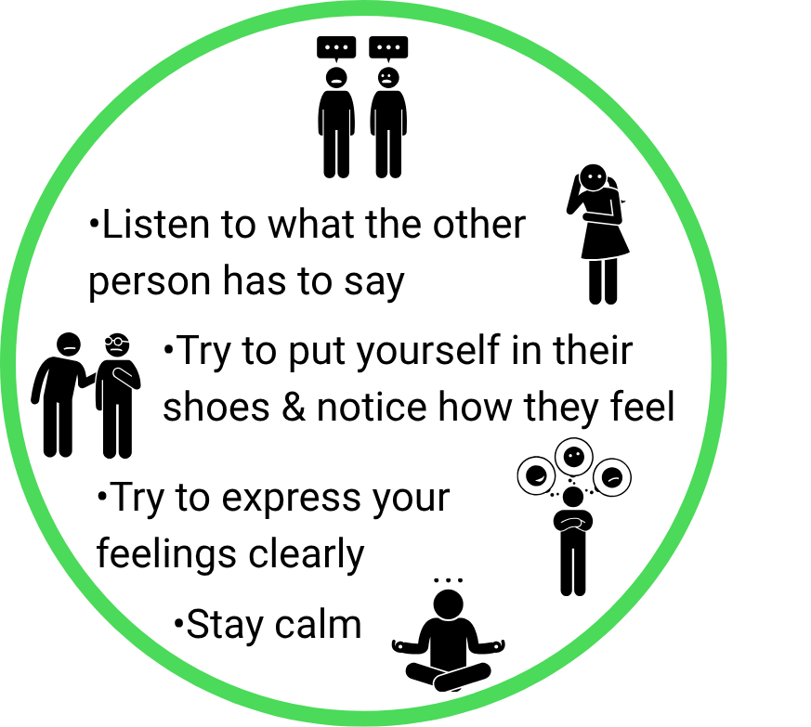
Powers for Good - when you don’t like someone
5. Remember your communication skills: If there is a problem, try to talk it through first, tell the person what is bothering you and try to work out how to fix it together.
If that doesn’t work, walk away
If THAT doesn’t work, ask for help

Slide 16




Your Powers for Good
Speak up Don’t be afraid to say ‘no’, to say ‘stop’ or to say ‘that’s unkind’ to bullying behaviour.
Tell a trusted adult
Encouraging someone to tell an adult or going with someone to get help
Be supportive and kind
Offer help, include others and notice how others are feeling
Take responsibility
You can behave nicely to others even if they are not your friends

