Slide 1
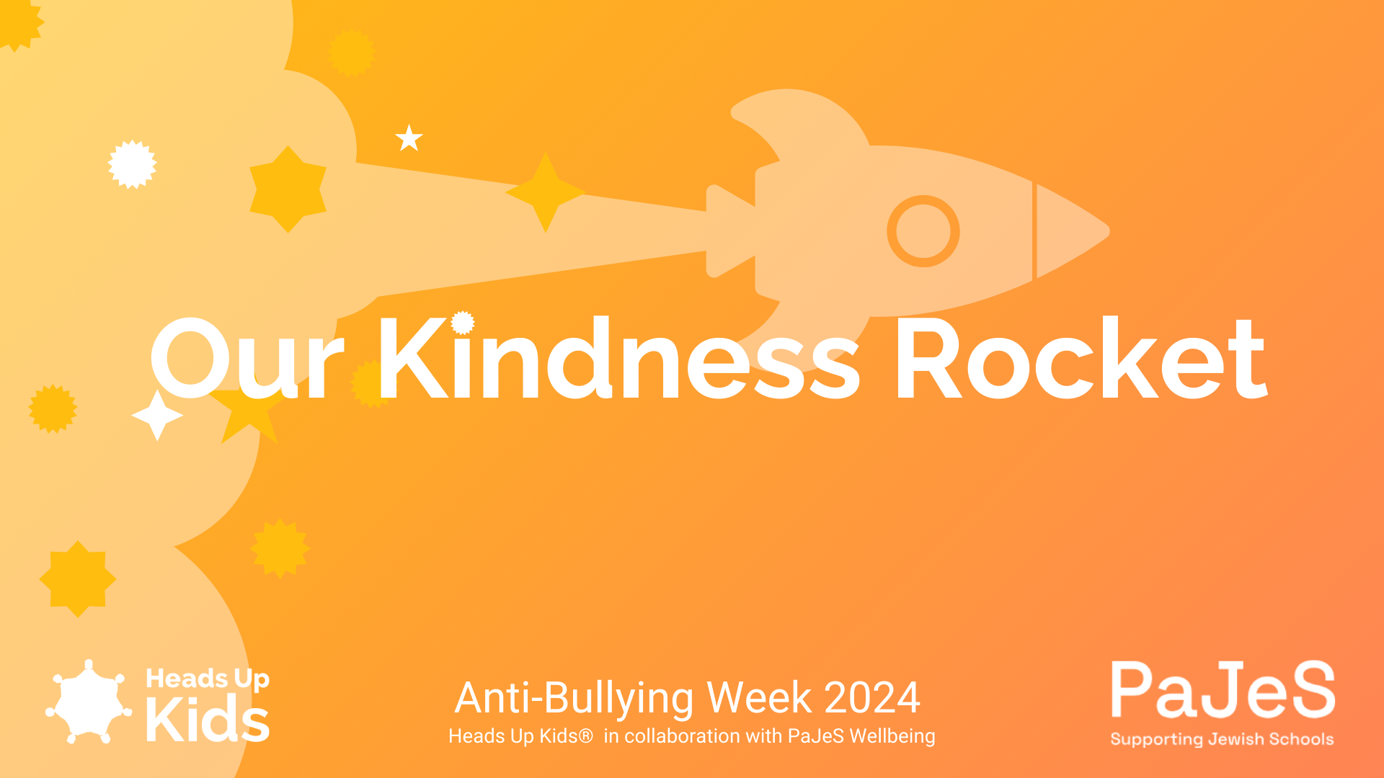


Slide 2

This week is anti-bullying week and the theme is Power for Good, we are going to think about…
What is bullying?
What are our powers for good?
How do we use our powers for good when we see bullying?

Slide 3


What is bullying?
Bullying is unkind behaviour.
It is being mean on purpose
And it happens again and again

Slide 4

What is bullying?
That means that the person or group doing it means to upset or hurt the person they are bullying
Bullying is intentional

Slide 5




Types of Bullying
Physical
hitting, kicking, pushing or damaging someone else's things on purpose
Verbal
name calling, teasing, saying nasty or unkind things to someone
Emotional
Saying things that aren’t true, playing unkind jokes or leaving people out.
Online
writing hurtful messages on a phone or computer

Slide 6
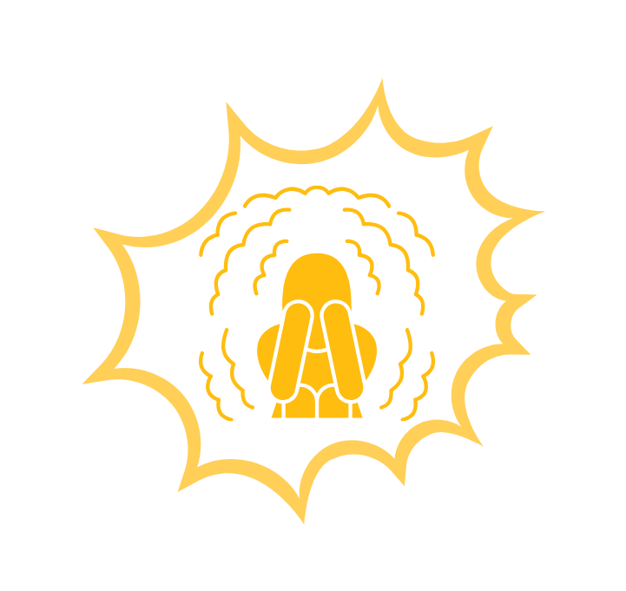

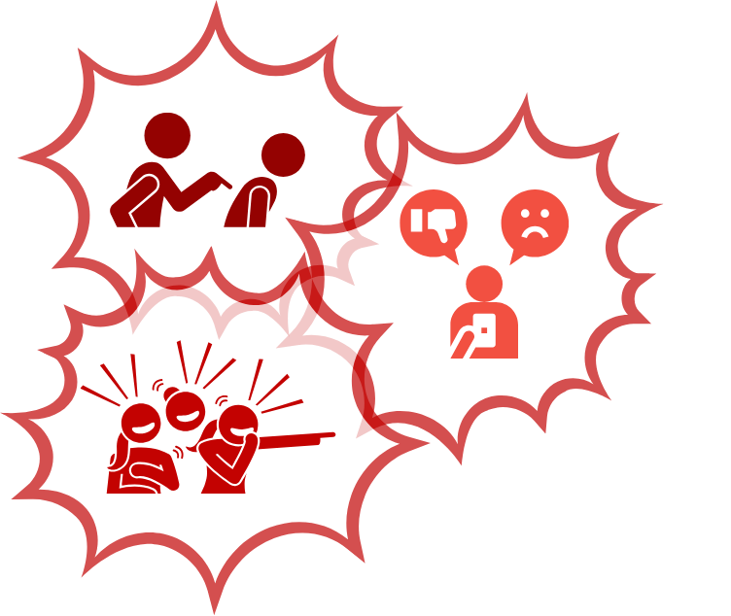
Who is involved in bullying?
‘Bystander’
Some who sees bullying happen
‘Target’
Someone who experiences bullying
‘Bullies’
A person or group that use bullying behaviour

Slide 7

What are our powers for good?
What are the things we can do to make a difference?
Smile
Be friendly
Be kind
Be helpful
Include others
Notice how others are feeling
Share
Take Turns
Invite others to join in
Help someone if they are hurt
Cheer someone up

Slide 8
How do we use our powers for good when we see bullying?
Ask someone if they need help
Ask someone if they want to join in
Say “no that's not nice”
Say “stop”
Give someone a hug or hold their hand
Take someone away from the situation and go play somewhere else
Tell a teacher or ask someone to come and help

Slide 9
Power for Good Power Shower
Let’s shower our class with good!
We are going to think about all the things we can do to use our powers for good.
Everybody will get a few small pieces of paper and on them you can write or draw your ideas for how you can use your powers for good.
We can remember some of the things we thought about.

Slide 10

Power for Good Power Shower
Everyone sits tightly together in a circle in the middle of the classroom.
Pick one piece up, open it up it and have a look. It will be your reminder to use your powers for good. You can put it in your pocket, keep it in your bag, or take it home.
We can remember to use your powers for good in the classroom, in the playground and at home.

